Slide 1

SendaWelcome Skittles
Welcome Pack

Slide 2

This Welcome Pack will give you information on:
What skittles is.
When the skittles sessions are.
Where the skittles sessions are.
Who will be leading the sessions.
How to get to the session by public transport.
The accessibility of the venue.
What to wear/bring to the session.
Contact details.
If you have any questions, please use the contact details on page 11 to get in touch.

Slide 3
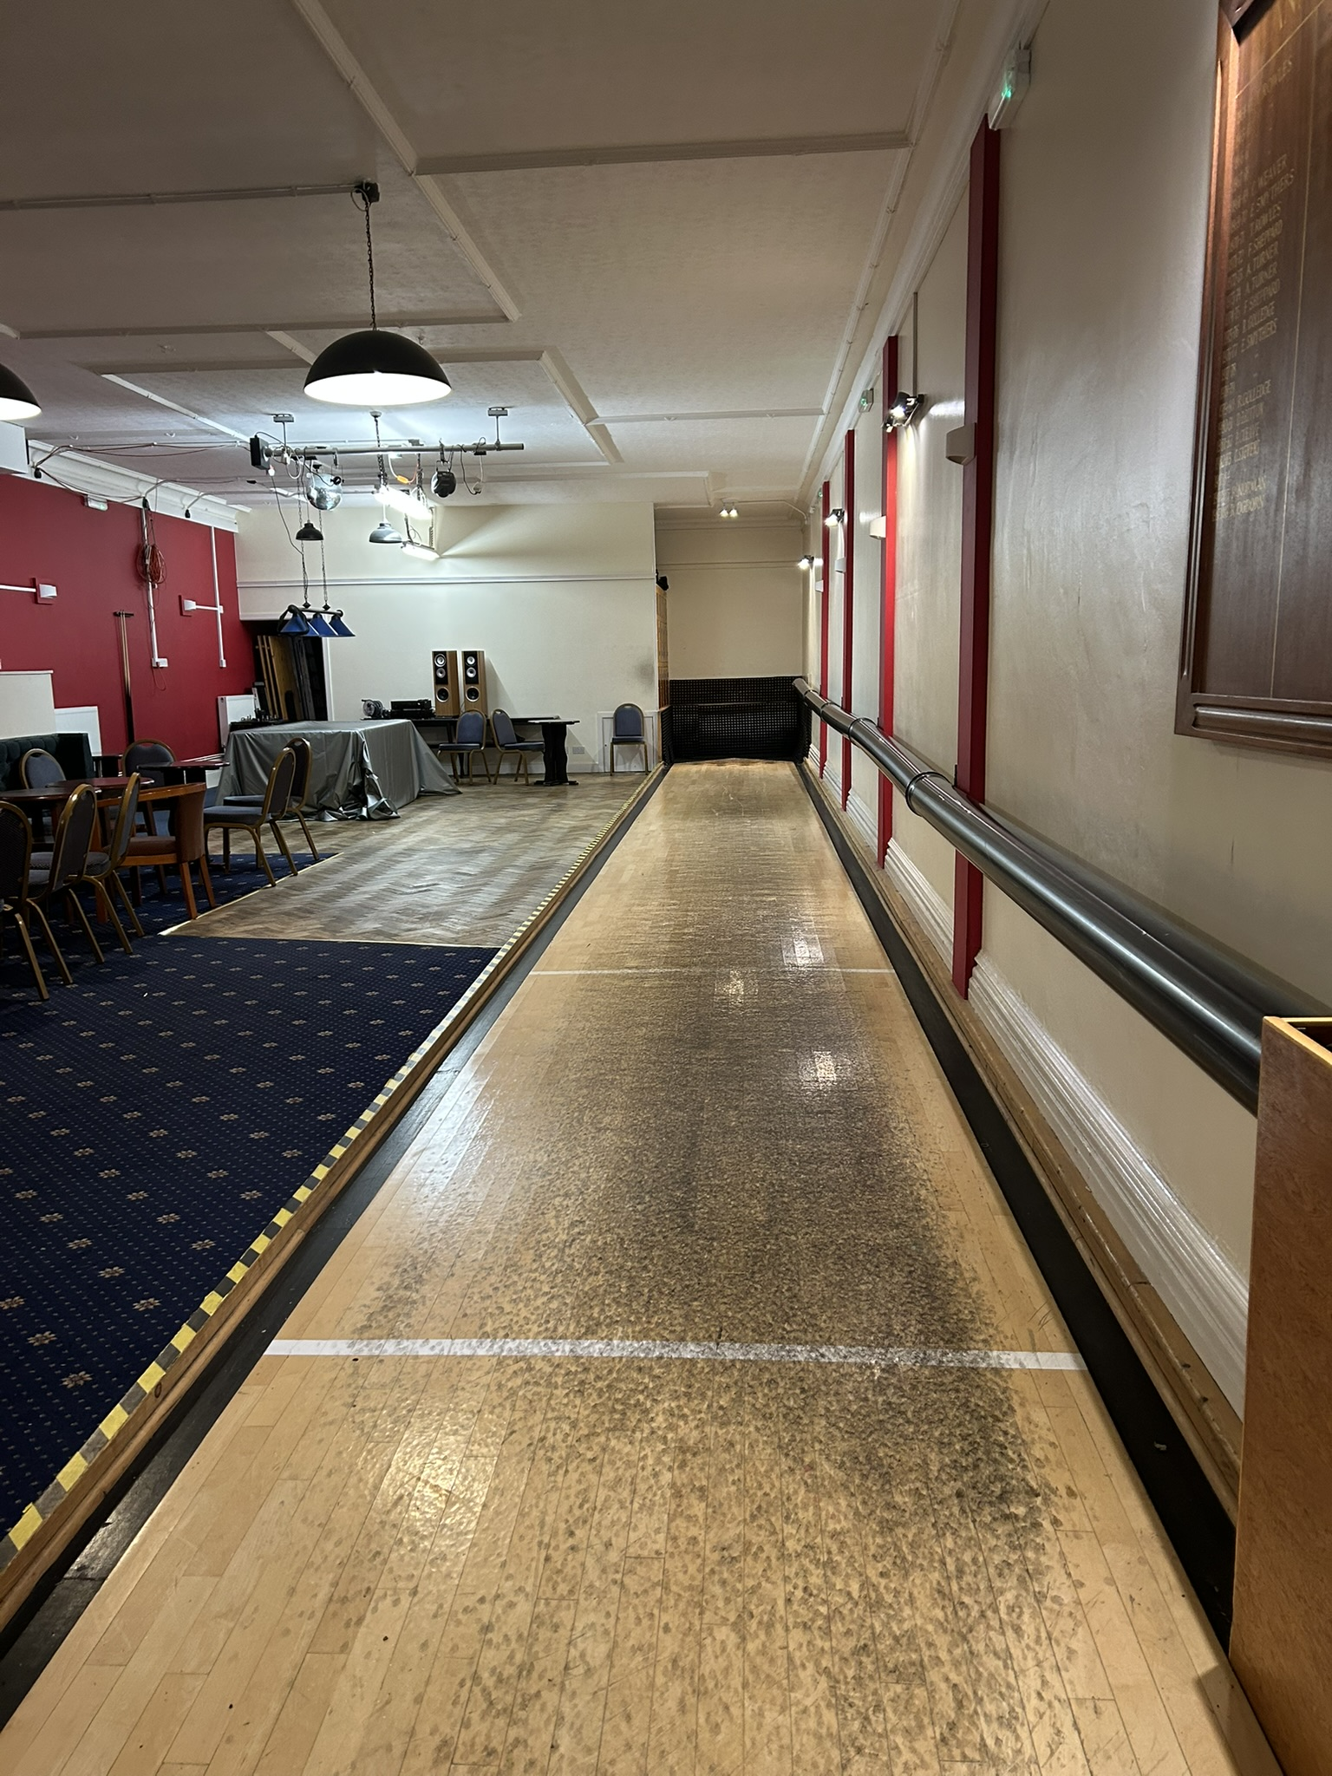
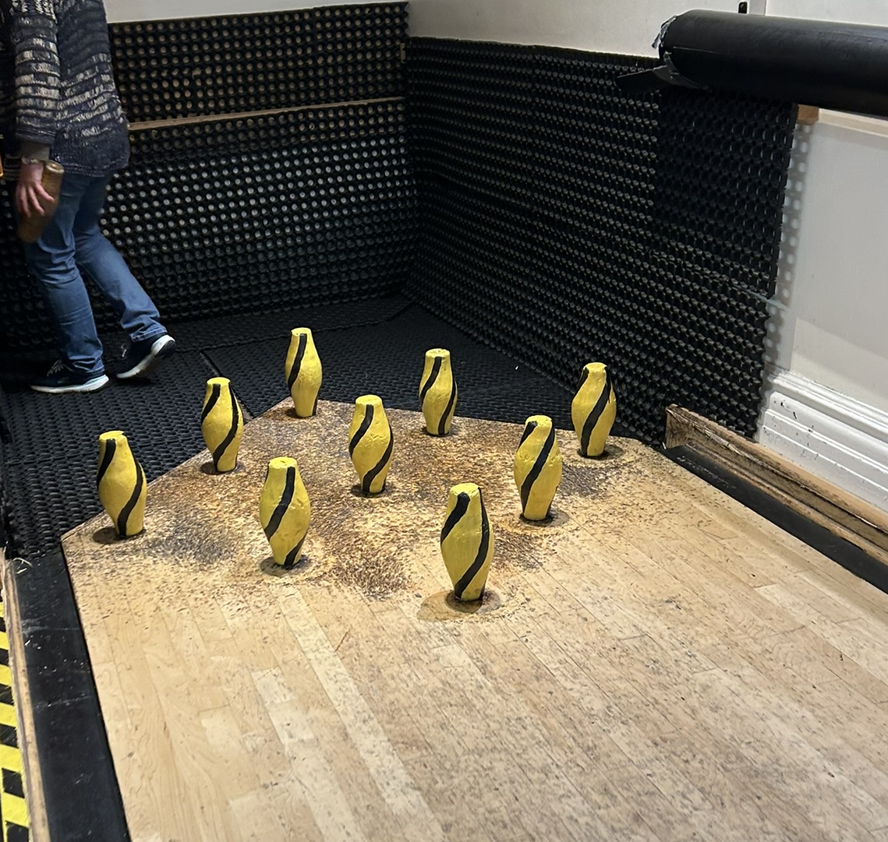
What is Skittles?
Skittles is a target practice game that’s fun, easy to learn and extremely sociable.
Skittles involves knocking down a set of wooden pins, by rolling a ball at them.
Played indoors on a skittle alley, groups of mixed ages and abilities can play together.

Slide 4
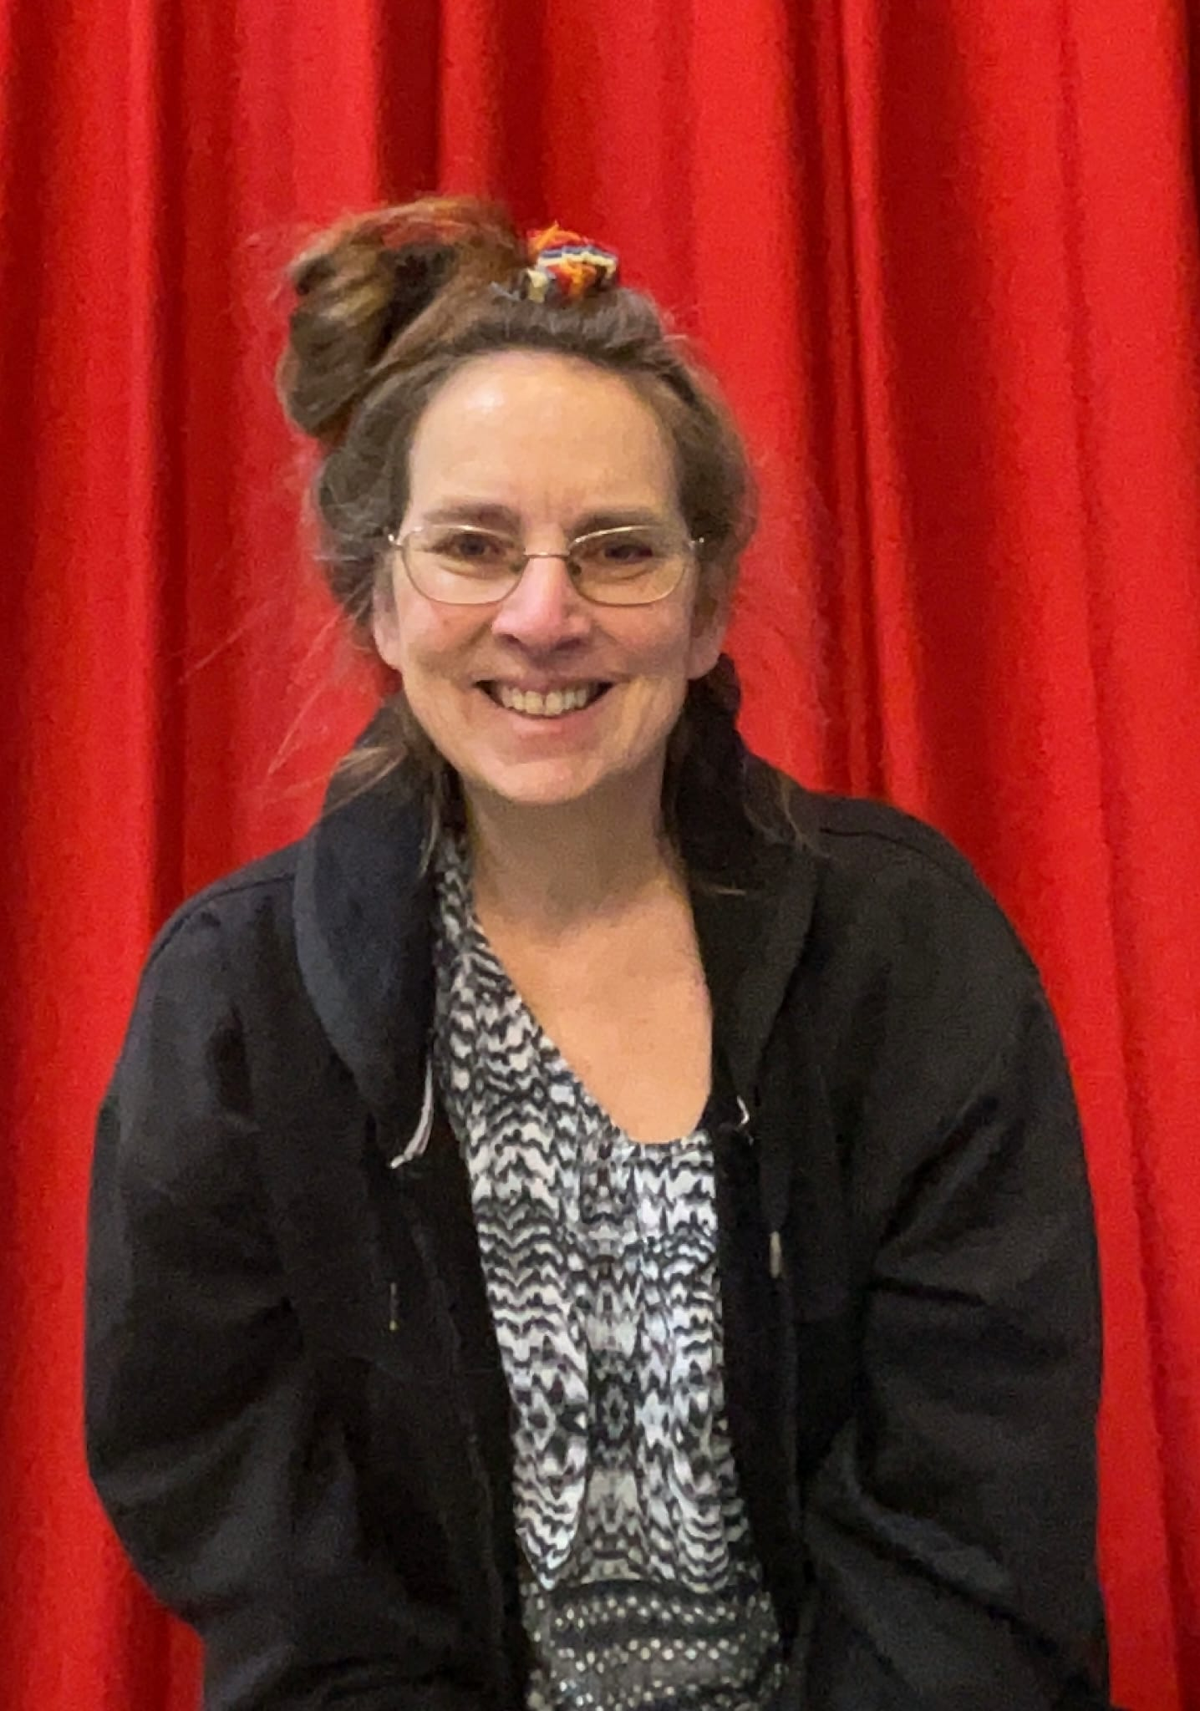
Who will be leading the Session?
Hi, I’m Jenny!
I will be leading the Skittles session.
I like playing boccia and similar games where I work at Claremont School. I have supported lots of people who have a wide variety of skills.
You can ask me anything, I am here to help.
I look forward to meeting you and having some fun knocking down Skittles.

Slide 5
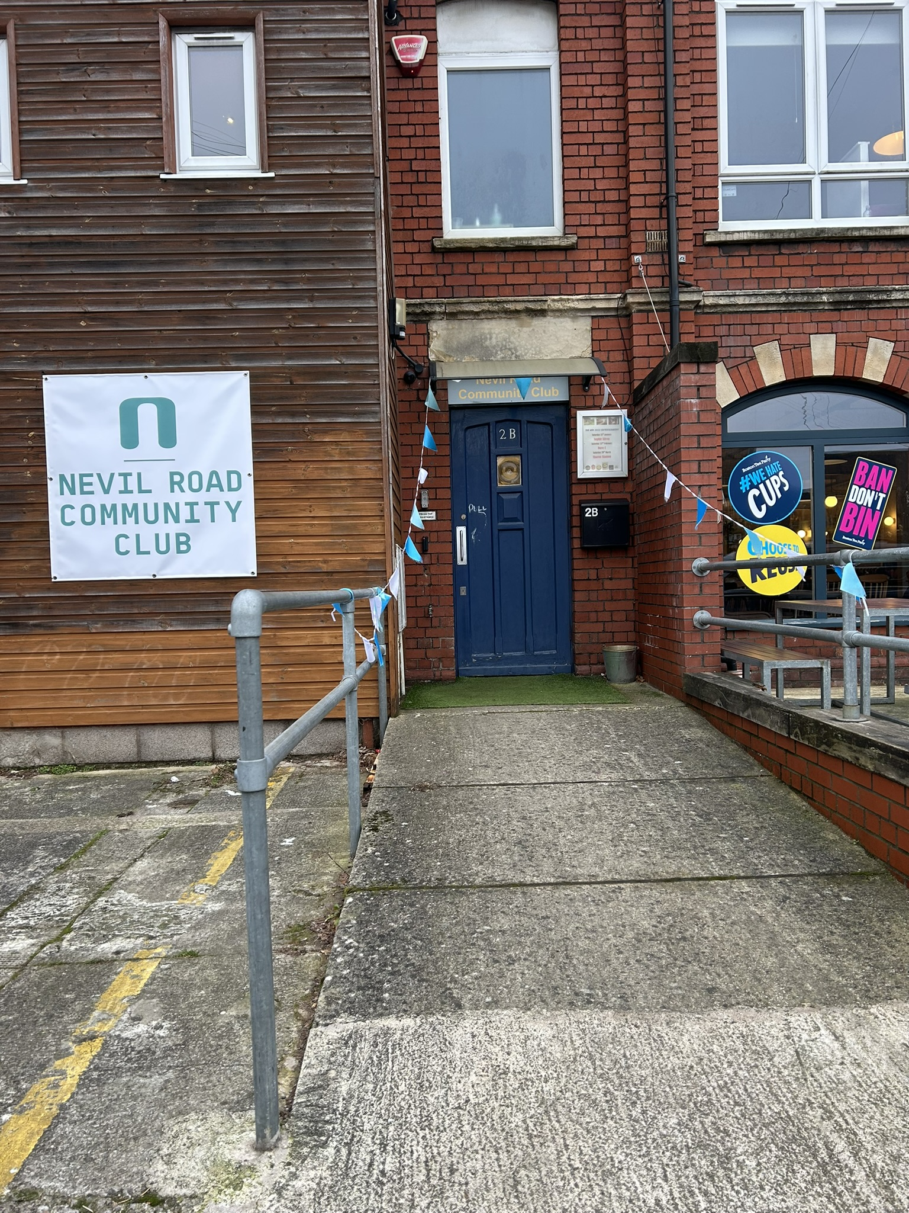
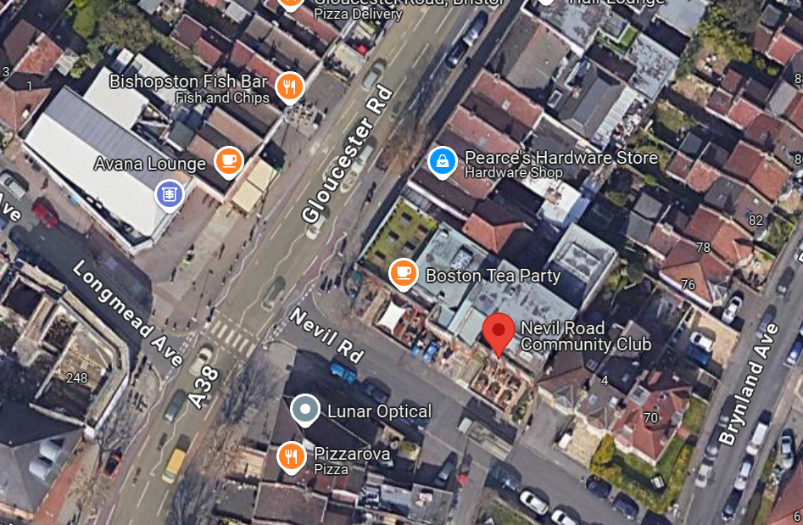
Venue Information:
Address:
The Nev Community Centre, 2B Nevil Road, Bishopston, BS7 9EQ
Skittles Alley is on the first floor.
For a google maps link, click here.
what3words: hatch.foster.chief

Slide 6
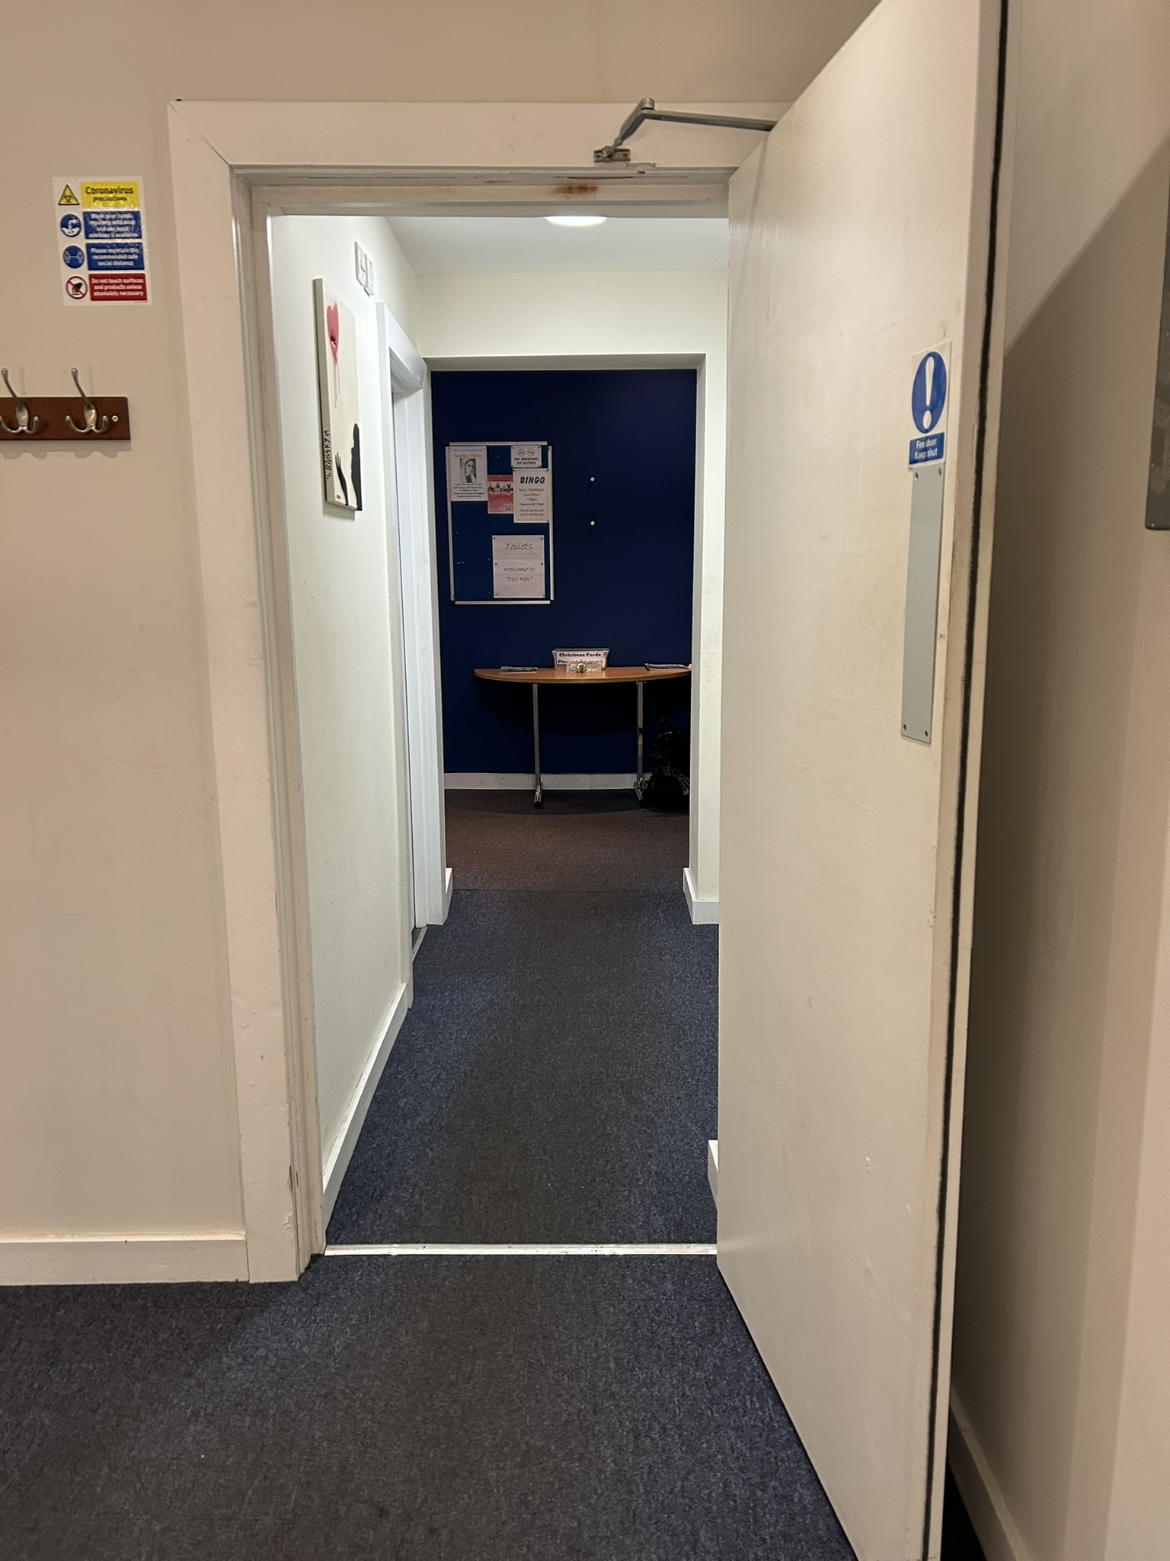
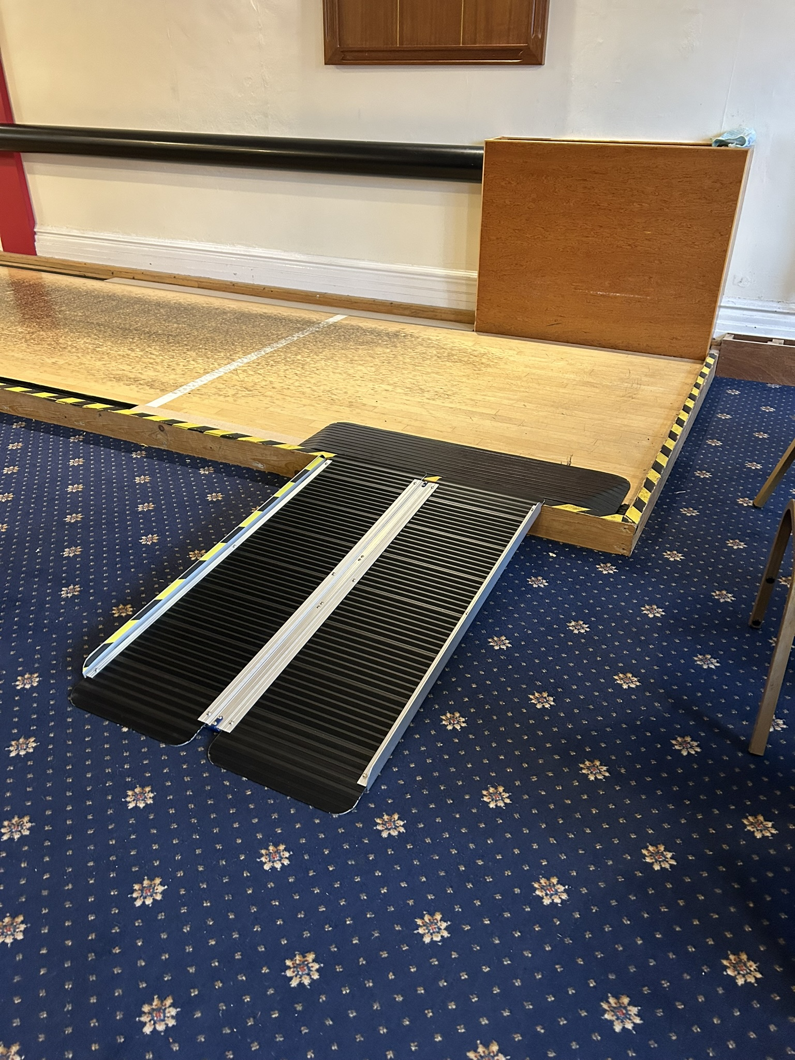
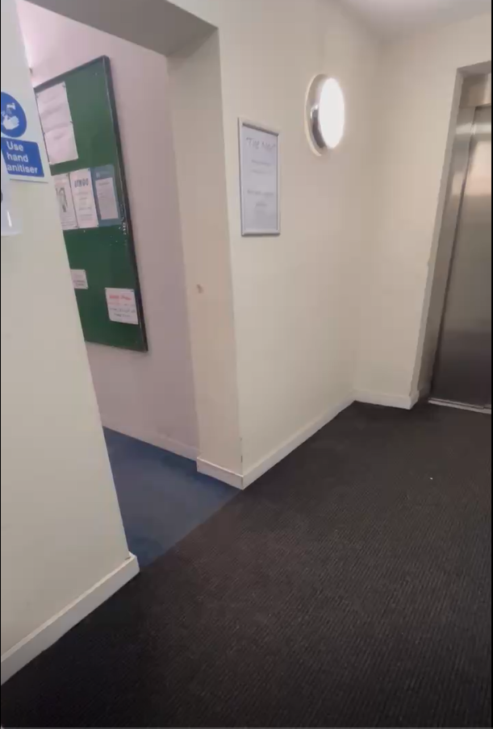
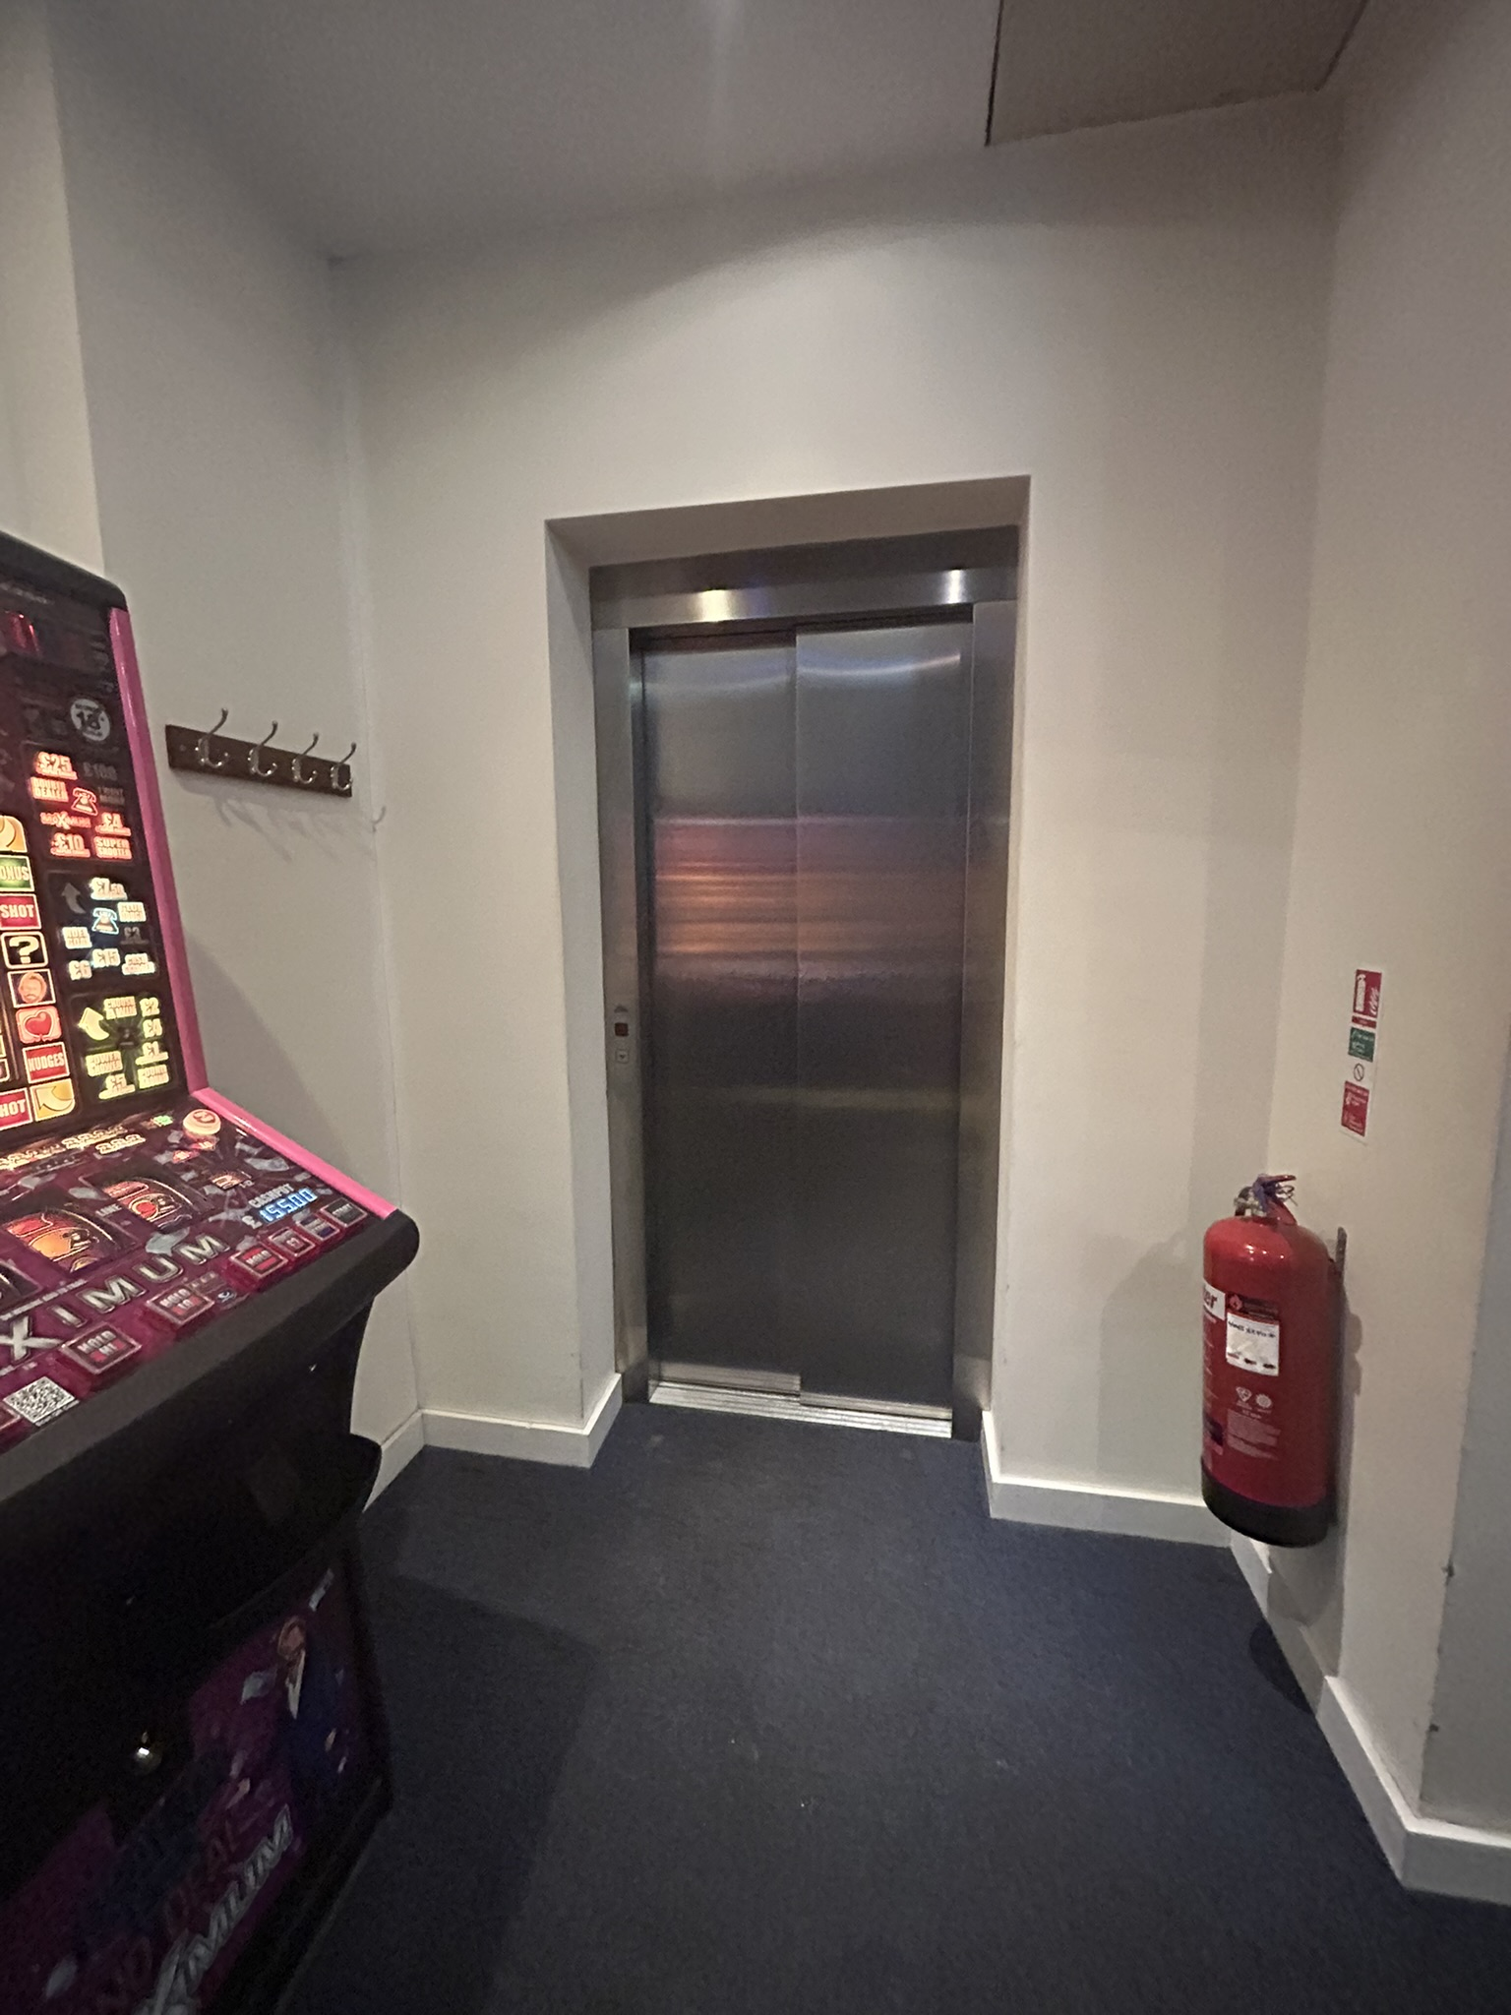
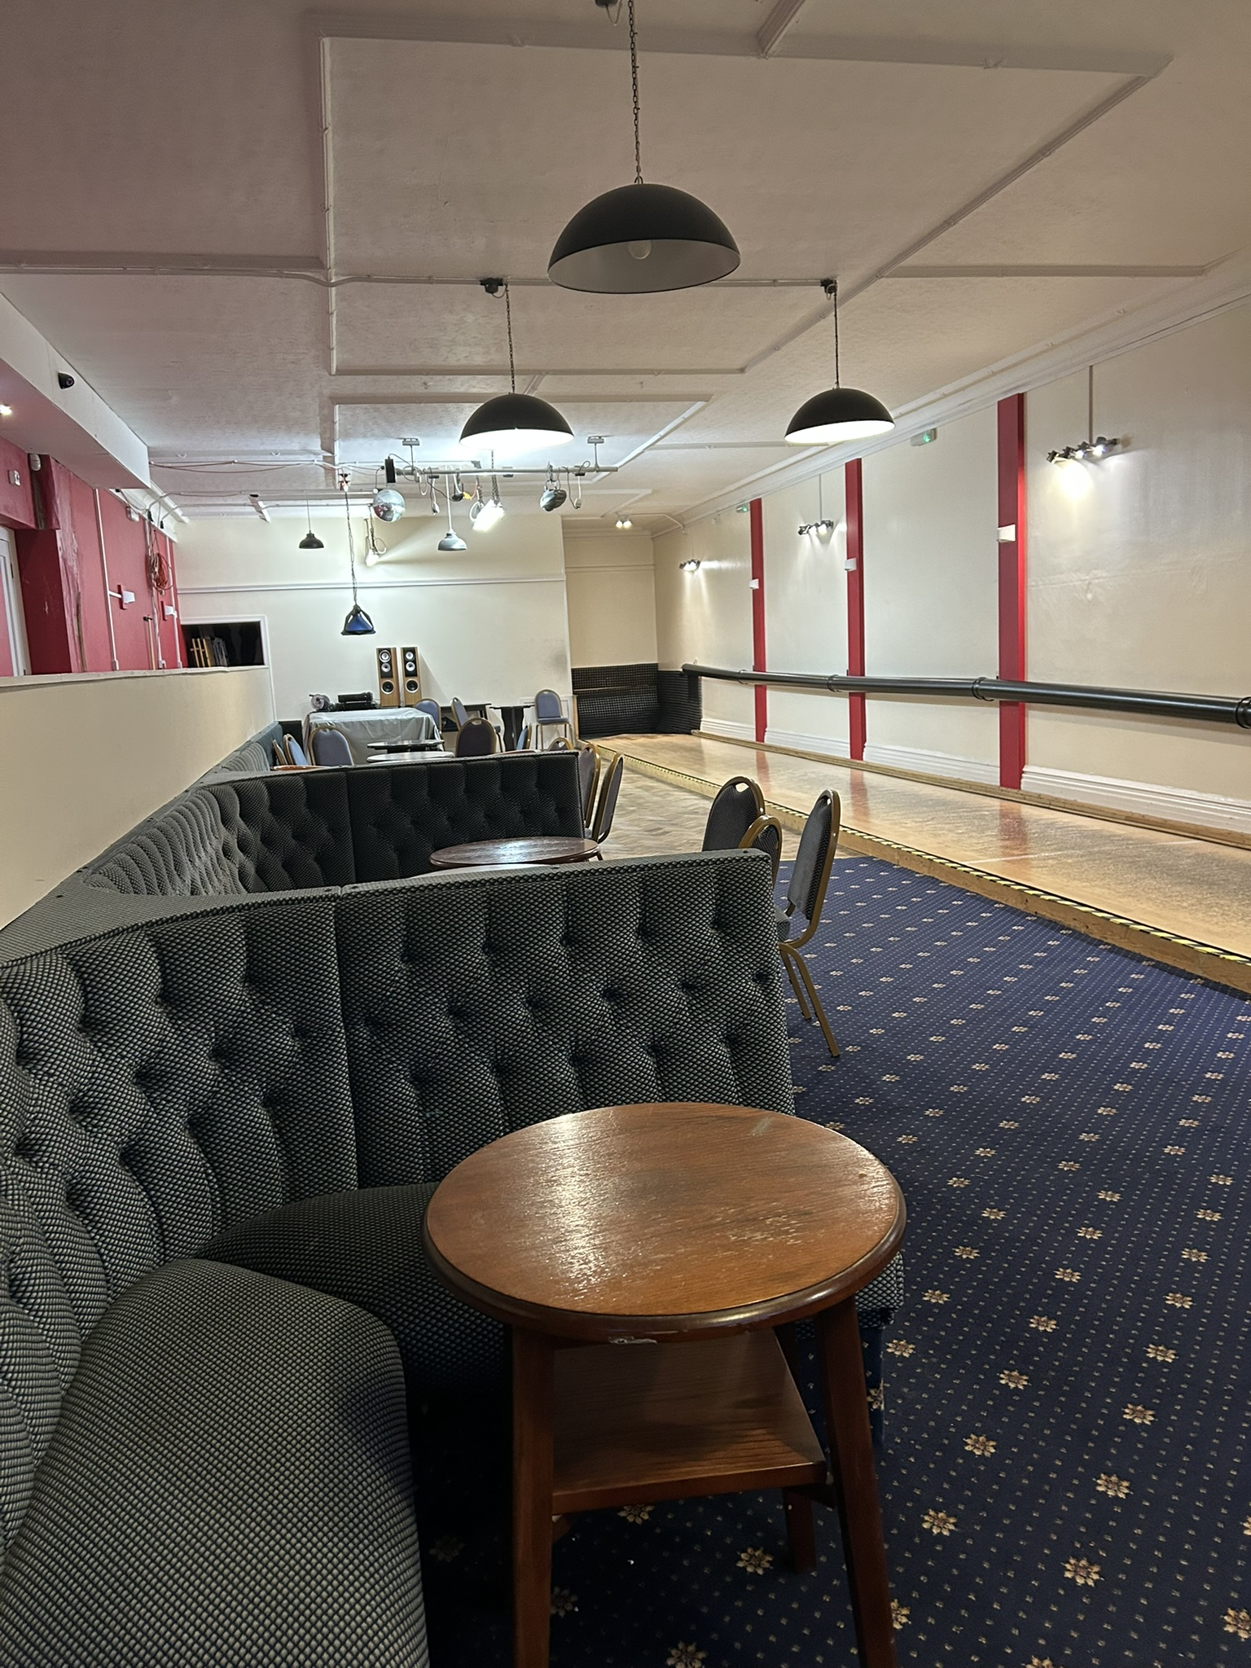
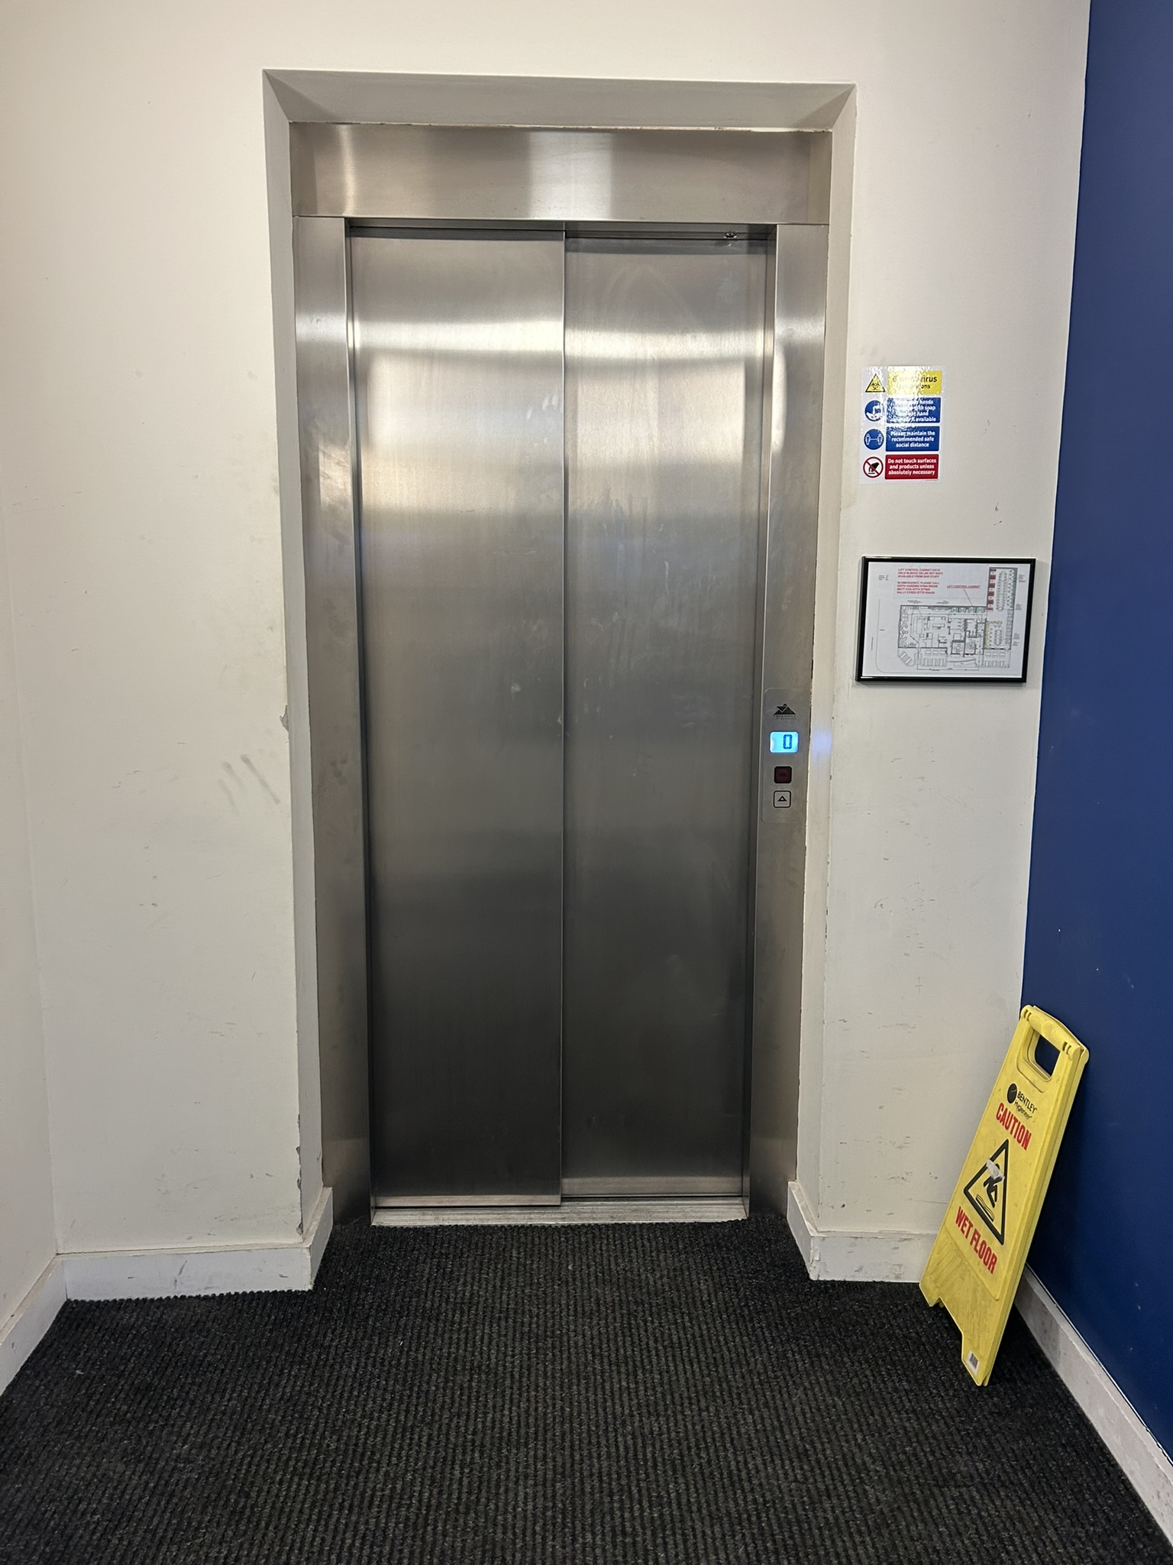
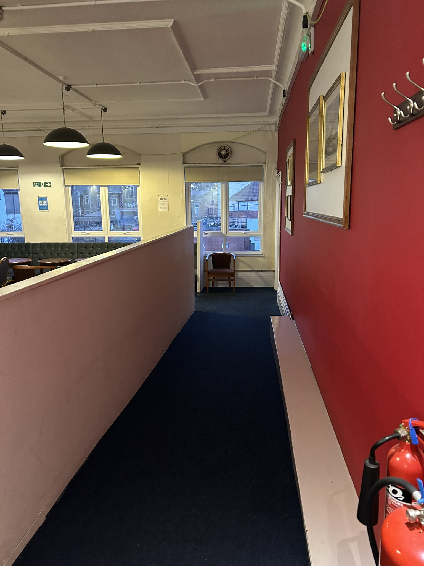
How to find the skittles alley:
4. If you used the stairs, go through this door at the top of the stairs and turn right. The door to the skittles alley is white.
7. This is the ramp to access the skittles alley.
1. Go through the blue door
2. The skittles alley is on the first floor. Turn left to go up two flights of stairs or go forwards to use the lift.
5. If you used the lift, the doors will open onto the first floor. Go forwards and right. The door to the skittles alley is white.
8. There are lots of tables and chairs next to the skittles alley.
6. Go through the white doors and turn right. Go down the ramp and turn left.
3. To use the lift, push the blue arrow button on the right.

Slide 7
Travelling by Public Transport:
Travelling by bus:
  Nevil Road bus stops are less than 0.1 miles away from Nevil Road Community Club. Google maps link here: Nevil Road Bus Stop.
  Bus routes 17 citylines, 71, 72, 73, 74, 75, 76 and 77 stop here.
  Bus timetables here: Bristol, Bath and the West | First Bus and Welcome to Stagecoach
Travelling by train:
Ashley Down train station is 0.7 miles away from Nevil Road Community Club.
  Google maps link to Ashley Down train station: Ashley Down Train Station
  Google maps link to directions from Ashley Down train station to Nevil Road Community Club: Ashley Down Train Station to Nevil Road
  Timetable for Ashley Down Train Station here: Ashley Down Station | National Rail

Slide 8




Accessibility
​Ramped/Sloped Access to the building and onto the skittles alley
Seat (s) available
Accessible lift
Accessible toilet and step free standard toilet
You are more than welcome to wear ear defenders or noise cancelling headphones
You can re-fill water bottles at the bar at the Nev Community Club
Jenny, who will be leading the session, will adapt activities to ensure that everyone can take part and has fun.
If you have any additional suggestions to improve accessibility, please contact us.

Slide 9
Frequently Asked Questions
What should I bring to the session?
A water bottle.
You can bring any sensory or fidget toys with you.
You can bring your own food and drink.
Please remember any medication you may need to use during the session or in case of an emergency.
What should I wear to the session?
There is no dress code, we recommend that you wear clothing that you feel comfortable in.
You can wear ear defenders or noise cancelling headphones
What time should I arrive for my first session?
If you’d like to arrive 10 minutes early for your first session, it would be great to have a chat and learn more about how we can best support you.
What happens if I can't find the venue?
If you would like help finding the venue on the day, please use the contact details provided on page 9.

Slide 10
Contact Details
If you have any questions and would like to speak to someone before the session, then please use the following details:
Email- laura.sendawelcome@gmail.com
Phone: 07386494801

